Slide 1
Opinion Analysis of Media Bias
CS5344: Project Proposal
Team: 42
Wu Tong, Yang Haohong
Notes:
Slide 1:
"Good morning everyone. Today, we are excited to present our project proposal titled 'Opinion Analysis of Media Bias.' We are Team 42; my name is Wu Tong, and this is my colleague, Yang Haohong."

Slide 2
Target task
We are working on Classification for Univariate Time Series by Improving an existing algorithm.
Main Task: Sentiment Classification
Analyzing the sentiment and opinion expressed by media outlets towards specific financial events in financial news.
Downstream Task: Stock Price Prediction
With the result of main task, analyzing whether the sentiment of news will affect stock prices and predicting the stock prices.
Notes:
Slide 2: Target Task
"Our project focuses on classification for univariate time series by improving an existing algorithm. Specifically, our main task is sentiment classification. We aim to analyze the sentiment and opinions expressed by media outlets towards specific financial events in financial news. Building on this, our downstream task involves stock price prediction. We'll investigate whether the sentiment extracted from news impacts stock prices and use this information to predict future stock movements."

Slide 3
Dataset
Singapore News Articles
The dataset focuses on analyzing news articles related to Singapore. This dataset is machine-annotated using traditional NLP methods
Financial Phrase Bank
This dataset (FinancialPhraseBank) contains the sentiments for financial news headlines from the perspective of a retail investor.
Million News Headlines
This contains data of news headlines published over a period of nineteen years. Sourced from the reputable Australian news source ABC.
Amazon Review Data
This dataset contains product reviews and metadata from Amazon, including 142.8 million reviews spanning May 1996 - Oct 2018.
This dataset includes reviews (ratings, text, helpfulness votes), product metadata (descriptions, category information, price, brand, and image features), and links (also viewed/also bought graphs).
Notes:
Slide 3: Dataset
"To achieve our objectives, we'll be utilizing several datasets:
Singapore News Articles: This dataset focuses on news articles related to Singapore and is machine-annotated using traditional NLP methods.
Financial Phrase Bank: It contains sentiments for financial news headlines from the perspective of a retail investor, providing valuable insights into market perceptions.
Million News Headlines: Sourced from the reputable Australian news outlet ABC, this dataset comprises news headlines published over nineteen years, offering a broad temporal perspective.
Amazon Review Data: With over 142 million reviews from May 1996 to October 2018, this dataset includes reviews, ratings, product metadata, and customer behavior graphs, which can enrich our sentiment analysis."

Slide 4
Dataset
Stanford Sentiment Treebank
is a corpus with fully labeled parse trees that allows for a complete analysis of the compositional effects of sentiment in language.
WordStat Sentiment Dictionary
classifies sentiments as negative or positive and combines three dictionaries, allowing for identifying synonyms and word patterns automatically.
Social Media Sentiment
captures diverse emotions and interactions across social media platforms, including text, timestamps, categorized emotions and etc.
Notes:
Slide 4: Dataset
"Additional datasets we'll incorporate include:
Stanford Sentiment Treebank: A corpus with fully labeled parse trees, allowing for comprehensive analysis of the compositional effects of sentiment in language.
WordStat Sentiment Dictionary: This resource classifies sentiments as negative or positive and combines three dictionaries, enabling automatic identification of synonyms and word patterns.
Social Media Sentiment: Capturing diverse emotions and interactions across social media platforms, this dataset includes text, timestamps, and categorized emotions, providing a dynamic view of public sentiment."

Slide 5
Dataset
Hotel Reviews
contains 1,000 hotels and their reviews, including details like location, rating, and review text. It can be used for aspects based sentiment analysis.
NewsMTSC
a dataset for target-dependent sentiment classification (TSC) on news articles reporting on policy issues. consists of more than 11k labeled sentences, which we sampled from news articles from online US news outlets
FNSPID
Financial News and Stock Price Integration Dataset is a comprehensive financial dataset designed to enhance stock market predictions by combining quantitative and qualitative data. It contains 29.7 million stock prices and 15.7 million financial news records for 4,775 S&P500 companies from 1999 to 2023
Notes:
Slide 5: Dataset
"We'll also use:
Hotel Reviews: Containing reviews of 1,000 hotels with details like location, rating, and review text, this dataset is suitable for aspect-based sentiment analysis.
NewsMTSC: A dataset designed for target-dependent sentiment classification on news articles reporting policy issues, consisting of over 11,000 labeled sentences from online US news outlets.
FNSPID (Financial News and Stock Price Integration Dataset): A comprehensive dataset combining quantitative and qualitative data to enhance stock market predictions, featuring 29.7 million stock prices and 15.7 million financial news records for 4,775 S&P 500 companies from 1999 to 2023."

Slide 6
Dataset
twitter-financial-news-sentiment
Dataset containing an annotated corpus of finance-related tweets used to classify finance-related tweets for their sentiment.
IMDB
Large Movie Review Dataset. This is a dataset for binary sentiment classification containing 25,000 highly polar movie reviews for training, and 25,000 for testing.
Yelp reviews
The Yelp reviews dataset consists of reviews from Yelp. It is extracted from the Yelp Dataset Challenge 2015 data. The dataset is mainly used for text classification: given the text, predict the sentiment.
Notes:
Slide 6: Dataset
"Moreover, we'll incorporate:
Twitter Financial News Sentiment: An annotated corpus of finance-related tweets used for sentiment classification in the financial domain.
IMDB Reviews: A large movie review dataset for binary sentiment classification, containing 25,000 highly polar movie reviews for both training and testing.
Yelp Reviews: Extracted from the Yelp Dataset Challenge 2015, this dataset is used for text classification, predicting sentiment based on review text."

Slide 7
Intended Approach
Preprocessing source data: apply methods like the stopword removal, negation handling, and convert emoticons to textual meanings to increase the precision. Apply feature engineering by construct additional features to contribute to the analysis.
Sentimental Analysis: Train word embedding or using the pre-trained BERT model, using attention mechanism as an add-on to increase the sensitivity of critical information.
Model Fusion: Using multiple models to extract features, including but not limited to RF, LR. Using specific mechanism to make a fusion of multiple models (voting, stacking).
Notes:
Slide 7: Intended Approach
"Our approach comprises several key steps:
Preprocessing Source Data: We'll enhance precision by removing stopwords, handling negations, and converting emoticons to their textual meanings. We'll also perform feature engineering to construct additional features that contribute to the analysis.
Sentiment Analysis: We'll train word embeddings or utilize pre-trained models like BERT. By incorporating attention mechanisms, we'll increase the model's sensitivity to critical information within the text.
Model Fusion: To improve performance, we'll employ multiple models such as Logistic Regression and Random Forest. We'll fuse these models using techniques like voting or stacking to leverage their combined strengths."

Slide 8
Evaluate method
For main task(Sentiment Classification): Accuracy, Precision, Recall, F1-Score.
For downstream task:
Apply the model into downstream tasks to help evaluate its performance indicator.
The downstream task will use time-series model to catch the time-dependencies features then predict the market, which is a good practise to show the relationship between media comments and the market.
Notes:
Slide 8: Evaluation Method
"For evaluating our main task—sentiment classification—we'll use metrics like accuracy, precision, recall, and F1-score to assess the model's performance.
For the downstream task of stock price prediction, we'll integrate our sentiment analysis model into time-series models. This will help us capture time-dependent features and predict market movements, thereby demonstrating the relationship between media sentiment and stock prices."

Slide 9
Challenges
Massive Data
The Singapore News Articles dataset contains 9,185,305 rows and takes up more than 8GB of space. Without using stream processing, it would be difficult to load it directly into memory and operate on it.
Domain adaptation
Our dataset includes general news, financial news, online shopping reviews, etc. Models trained on one or a few datasets may not perform well in other domains.
Label Accuracy
The ground truth labels of many datasets are generated by traditional NLP tools, which may not always be correct. We might need to leverage LLMs to generate higher-quality data.
Notes:
Slide 9: Challenges
"We anticipate several challenges:
Massive Data: The Singapore News Articles dataset contains over 9 million rows and exceeds 8 GB in size. Processing such large datasets requires stream processing techniques, as loading it entirely into memory isn't feasible.
Domain Adaptation: Our datasets span general news, financial news, and online shopping reviews. Models trained on one domain may not perform well on others due to differences in language and context.
Label Accuracy: Many datasets have ground truth labels generated by traditional NLP tools, which may not always be accurate. We may need to leverage large language models to generate higher-quality data for better results."

Slide 10
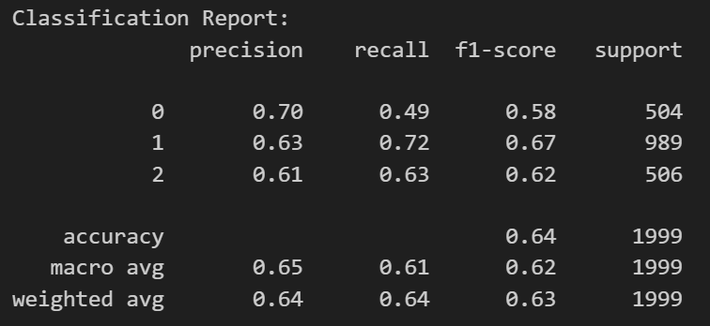
Comparison baseline
Dataset: subset of Singapore News Articles
Baseline 1:
TF-IDF + Logistic Regression
Notes:
Slide 10: Comparison Baseline
"As a starting point, we established baselines using a subset of the Singapore News Articles dataset.
Baseline 1: Using TF-IDF features with Logistic Regression, we achieved a precision of 0.70, recall of 0.49, and an F1-score of 0.58."

Slide 11
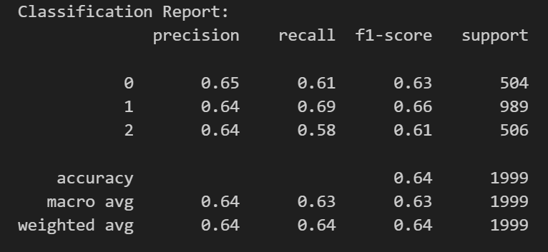
Comparison baseline
Dataset: subset of Singapore News Articles
Baseline 2:
BERT Embedding + Logistic Regression
Notes:
Slide 11: Comparison Baseline
"- Baseline 2: By employing BERT embeddings with Logistic Regression, the results improved slightly, yielding a precision of 0.65, recall of 0.61, and an F1-score of 0.63."

Slide 12
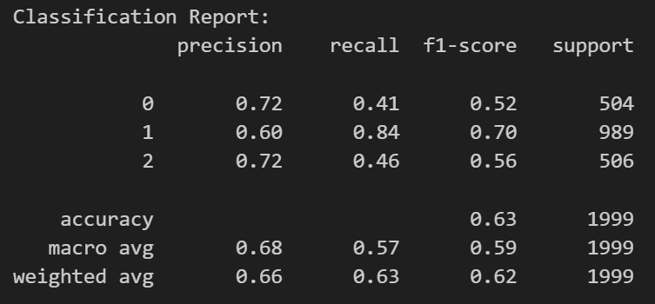
Comparison baseline
Dataset: subset of Singapore News Articles
Baseline 3:
BERT Embedding + Random Forest
Notes:
Slide 12: Comparison Baseline
"- Baseline 3: Combining BERT embeddings with a Random Forest classifier, we obtained a precision of 0.72, but the recall dropped to 0.41, resulting in an F1-score of 0.52. While the precision is higher, the lower recall indicates the model misses more relevant instances."

Slide 13
Thanks !!

